Slide 1
Unit IV
Memory Organization

Slide 2
Memory Hierarchy
Magnetic Tapes
I/O Processor
Main Memory
Magnetic Disks
Auxiliary memory
CPU
Cache
Memory

Slide 3
Main Memory
Relatively large
Relatively fast
Stores program and data during computer operation
Basic technology – semiconductor integrated circuits
Two types
  Static RAM
  Dynamic RAM

Slide 4
Main Memory (contd..)
Static RAM
  Internal flip-flops stores binary information
  Information remains valid as long as power is applied
  Easier to use and shorter read-write cycle
Dynamic RAM
  Binary information is stored in the form of electrical charges applied to capacitors
  Stored charges tends to discharge with time
  Needs to be periodically recharged.
  Reduced power consumption
  Larger storage capacity

Slide 5
RAM Chip
Chip select 1
CS1
CS2
Chip select 2
8-bit Data bus
128 x 8
RAM
Read
RD
Write
WR
7-bit address
AD7

Slide 6
Function table of a RAM chip
CS1 | CS2 | RD | WR | Memory function | State of data bus
0 | 0 | X | X | Inhibit | High-impedance
0 | 1 | X | X | Inhibit | High-impedance
1 | 0 | 0 | 0 | Inhibit | High-impedance
1 | 0 | 0 | 1 | Write | Input data to RAM
1 | 0 | 1 | X | Read | Output data from RAM
1 | 1 | X | X | Inhibit | High-impedance

Slide 7
ROM Chip
Chip select 1
CS1
CS2
Chip select 2
8-bit Data bus
512 x 8
ROM
9-bit address
AD9

Slide 8
An example main memory
Consider a main memory to be constructed with 512 RAM and 512 ROM.
Say, only 128 x 8 RAM chips are available and 512 x 8 ROM chips are available
So, we need 4 RAM chips and 1 ROM chip to construct the memory

Slide 9
Memory address map
Component | Hexadecimal Address | 10 | 9 | 8 | 7 | 6 | 5 | 4 | 3 | 2 | 1
RAM 1 | 0000-007F | 0 | 0 | 0 | X | X | X | X | X | X | X
RAM 2 | 0080-00FF | 0 | 0 | 1 | X | X | X | X | X | X | X
RAM 3 | 0100-017F | 0 | 1 | 0 | X | X | X | X | X | X | X
RAM 4 | 0180-01FF | 0 | 1 | 1 | X | X | X | X | X | X | X
ROM | 0200-03FF | 1 | X | X | X | X | X | X | X | X | X

Slide 10
Search Procedure
Searching for a data in memory consists of -
  Choosing a sequence of addresses,
  Reading their content
  Comparing with the item being searched until a match is found.
Searching becomes faster if memory unit is accessed by content and not by address.

Slide 11
Associative Memory Or
Content Addressable Memory
A memory unit accessed by content.
To write a word, the memory finds an unused location to store the word.
For reading, the content of the word or part of it is used to locate all words that match the input and mark them for reading.
Expensive as memory cell require additional logic circuit for matching content.

Slide 12
Hardware Organization
Argument Register (A)‏
Key Register (K)‏
Match Register
Associative memory array and logic
m words
n bits per word
M
Input
Read
Write
Output

Slide 13
Description
A and K has n bits, M has m bits.
Each word is compared in parallel with the contents of A.
The words that match set the corresponding bit in M.
After matching, a sequential access to memory is made for those words to which the corresponding bit is set in M.
K contains a mask for choosing a particular field in A.

Slide 14
Example
  A 101 111100
  K 111 000000
  Word 1 100 111100 no match
  Word 2 101 000001 match

Slide 15
Associative memory of m words, n cells per word
A₁
A_{j}
A_{n}
K₁
K_{j}
K_{n}
Word 1
C₁₁
C_{1j}
C_{1n}
M₁
Word i
C_{i1}
C_{ij}
C_{in}
M_{i}
C_{m1}
C_{mj}
C_{mn}
M_{m}
Word m
Bit 1
Bit j
Bit n

Slide 16
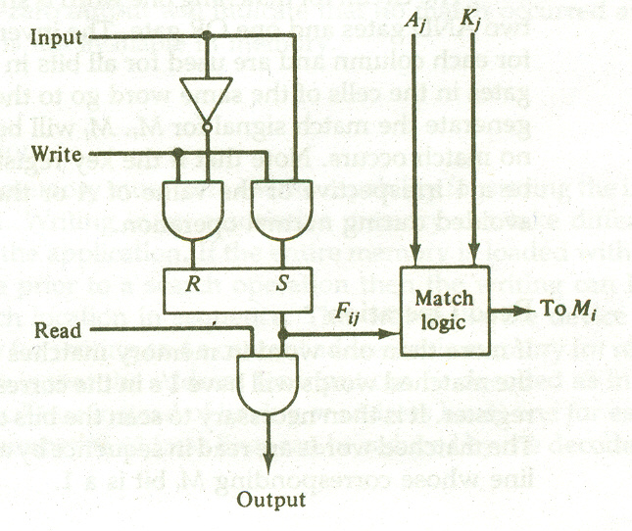
One Cell of Associative Memory

Slide 17
Match Logic (1/2)‏
First, neglect key bits(K) and compare the argument stored in A with the bits stored in the cells of the word.
Word i is equal to A if Aj = Fij , for j=1,2,….n
xj=AjFij +Aj’Fij’ , xj=1 if the pair of bits in position j are equal ; otherwise 0.
Mi=1 if all xj are 1 i.e Mi=x1x2x3…xn

Slide 18
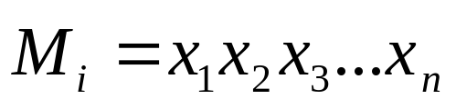
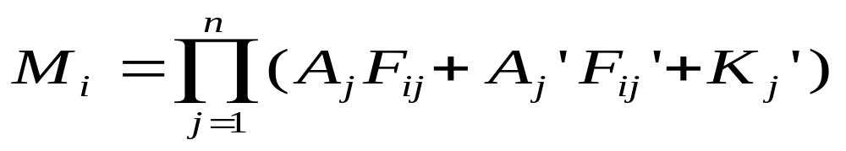
Match Logic (2/2)‏
Next, take the key register (K)‏
Aj and Fij needs comparision only if Kj=1
xj+Kj’= xj if Kj=1
= 1 if Kj=0
So,

Slide 19
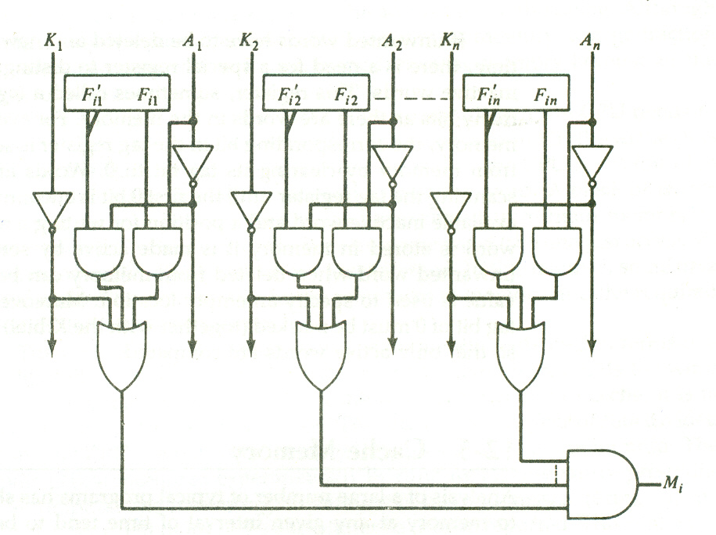
Match Logic for one word

Slide 20
Read Operation
All words which match the contents of A will have 1's in corresponding bits of M.
Scan bits of M and read in sequence all words with a 1 in M.

Slide 21
Write Operation (1/2)‏
Load entire memory with new data
  Address each location inn sequence.
  Instead of m address lines, the address input can be decoded d lines, m=2^{d}
Delete unwanted words and insert new words
  Tag register to keep track of active and inactive words.
  Corresponding bits in tag register 1 if active, 0 otherwise.

Slide 22
Write Operation (2/2)‏
  To delete word, mark corresponding bit in tag register to 0.
  To insert new word, scan tag register for first 0, store word at that position, mark bit in tag register 1.
  Unwanted words can be cleared to 0s.

Slide 23
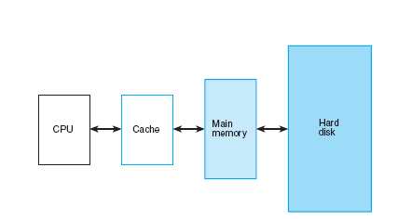
Memory Hierarchy

Slide 24
Cache Memory (1/3)
Locality of reference:
  References to memory in a interval is within some localized areas in memory.
Active portions of program and data placed in very fast memory.
Cache memory- fast and small
Sits between normal main memory and CPU
May be located on CPU chip or module

Slide 25

Cache Data Transfer

Slide 26
Cache Memory (2/3)
CPU needs to access memory- examines cache.
If found in cache, read from cache.
If not found ,transfer block of words containing the word accessed from main memory to cache.
Read from cache to CPU.

Slide 27

Cache Memory (3/3)
If CPU finds word in cache, it is a hit.
If word not found in cache, it is a miss.
Hit Ratio =

Slide 28
Cache Design
Size
Mapping Function
Replacement Algorithm
Write Policy
Block Size
Number of Caches

Slide 29
Size does matter
Cost
  More cache is expensive
Speed
  More cache is faster (up to a point)
  Checking cache for data takes time

Slide 30
Cache Mapping
Transformation of data from main memory to cache.
Three types of cache mapping:
  Associative mapping
  Direct mapping
  Set-associative mapping

Slide 31
Mapping example
Main Memory
  32K words of 12 bits each
  15-bit memory address
Cache
  512 words of 12 bits each
  12-bit cache address
CPU
Main Memory
32K x 12
Cache memory
512 x 12

Slide 32
Associative Mapping (1/2)
Associative memory stores both content and address of memory word.
15-bit memory address is placed in argument register.
Searching is done to find a matching address.
If found, 12-bit data is read and sent to CPU.
If no match, search main memory and transfer address-data pair to cache.
If no place for new entry, some existing entry is replaced according to some replacement policy.

Slide 33
Associative Mapping (2/2)
CPU address (15-bits)
Argument Register
Address
Data
01000
3450
02777
6710
22345
1234

Slide 34
Direct Mapping (1/3)
Associative memory expensive, so use random access memory for cache.
Address is in two parts – index and tag.
No. of bits in index field is equal to the no. Of address bits required to access cache memory.
For 2^{k} words in cache and 2^{n} words in main memory, n-bit memory address is divided into k-bit index and n-k-bit tag.

Slide 35
Direct Mapping (2/3)
6 bits 9 bits
Tag
Index
000
512 x 12
Cache Memory
Address = 9 bits
Data = 12 bits
32K x12
Main Memory
Address = 15 bits
Data = 12 bits
00 000
Octal Address
777
77 777
Octal Address

Slide 36
Direct Mapping (3/3)
Cache stores data along with tag.
CPU generates memory request.
Index field is used to access cache.
Tag fields is compared with the word read from cache.
If match then hit else miss.
If miss, read word from main memory and store in cache along with tag.

Slide 37
Advantages & Disadvantages
Simple
Inexpensive
Fixed location for given block
  If a program accesses 2 blocks that map to the same line repeatedly, cache misses are very high.

Slide 38
Direct Mapping Cache Organization
Memory Address
Index Address
00000
1220
00
1220
000
00777
2340
01000
3450
777
02
6710
01777
4560
02000
5670
02777
6710

Slide 39
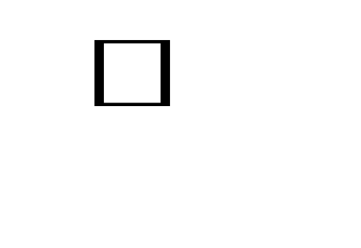
Direct Mapping with Block size of 8 words
000
01
3450
Block 0
index
007
01
6578
Tag
Block
Word
6 6 3
770
02
1234
Block 63
777
02
5231

Slide 40
Set Associative Mapping
Each word of cache can store two or more words of memory with the same index but different tag.
All data items along with their tags, having the same index is called a set.
CPU generates memory address, index value is used to access cache.
Associative search is done on the tag values for each data item stored in the cache at that index.
If hit, read from cache, else bring data from main memory.

Slide 41
Two-way Set Associative mapping
000
01
3450
02
5670
777
02
6710
00
2340
index

Slide 42
Replacement Policies
First-In First-Out
  Replace the item that has been in the set for the longest time.
Least Recently Used
  Replace the item which was least recently used by the CPU
Random
  Replace any item randomly.

Slide 43
Writing to Cache
Write-Through
  For every write operation for any item in the cache, updation is done in parallel to the item in main memory.
  Advantage : main and cache memory always holds the same data.
Write-Back
  Only cache is updated by a write. Location marked by a flag.
  When word is replaced from cache, check this flag and update main memory only if this bit is set.
  Advantage : frequent updation of main memory not required as data is always read from cache.

Slide 44
Cache Initialization
Cache initialized when
  Power is applied to the computer.
  Main memory is loaded with a set of programs.
Cache includes special bit called valid bit.
Initially all valid bits set to 0.
When a word is loaded from main memory, this bit is set to 1.
Also, a word is replaced only if its valid bit is 1.

